Slide 1
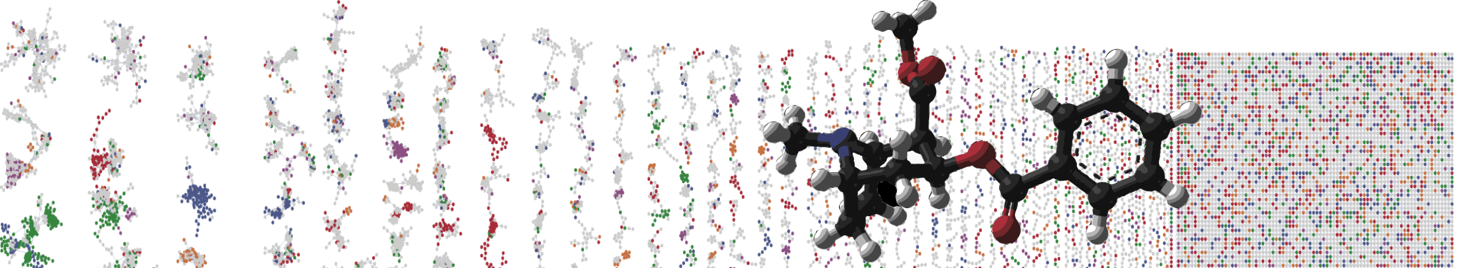


Substructure analysis with GNPS and MS2LDA
Hands On
ENTER AUTHORS HERE
University of California - San Diego

Slide 2
Objectives and Data
Utilize GNPS online interface to run MS2LDA
Explore substructure patterns in MS2LDA.org web app
Link to the GNPS job:
https://gnps.ucsd.edu/ProteoSAFe/status.jsp?task=7fff1d8a2d1641d2b9a098e58e41fb95
GNPS Tutorial Module – Substructure analysis with MS2LDA

Slide 3
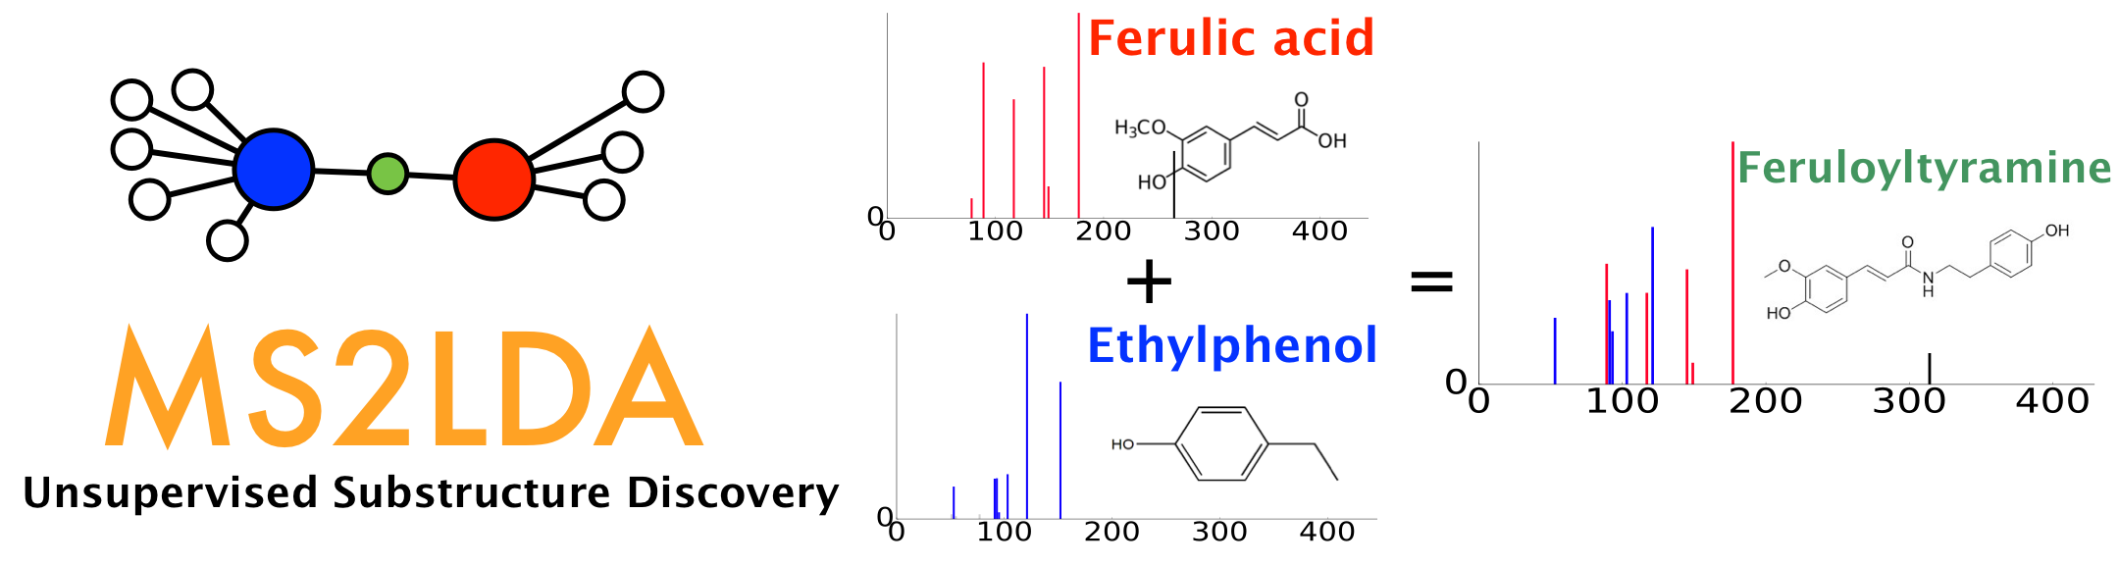
Substructure analysis by finding fragmental patterns
Topic modelling for metabolomics
GNPS Tutorial Module – Substructure analysis with MS2LDA

Slide 4
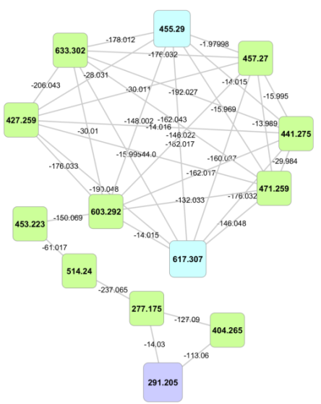
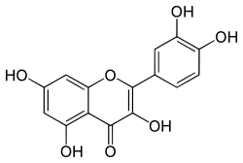
Motivation
MS2
Quercetin aglycone
m/z
Manual interpretation of fragmentation patterns guide in annotation and chemical classification
Automated recognition of mass fragmental motifs speeds up analysis and enables it at large scale
Software tool can be linked to other analyses
MS2
MS2
MS2
MS2
MS2
m/z
m/z
m/z
m/z
m/z
GNPS Tutorial Module – Substructure analysis with MS2LDA

Slide 5
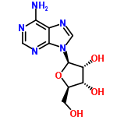
Fundamentals
Documents <-> molecules
Words <-> fragments and neutral losses
GNPS Tutorial Module – Substructure analysis with MS2LDA

Slide 6
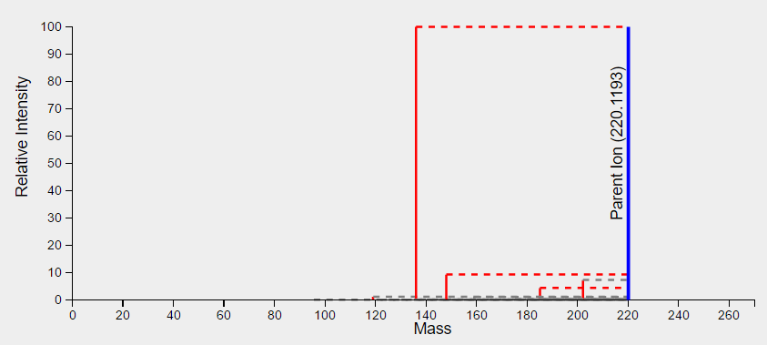
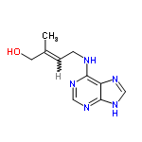
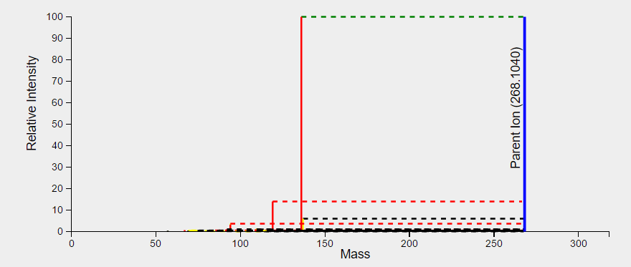
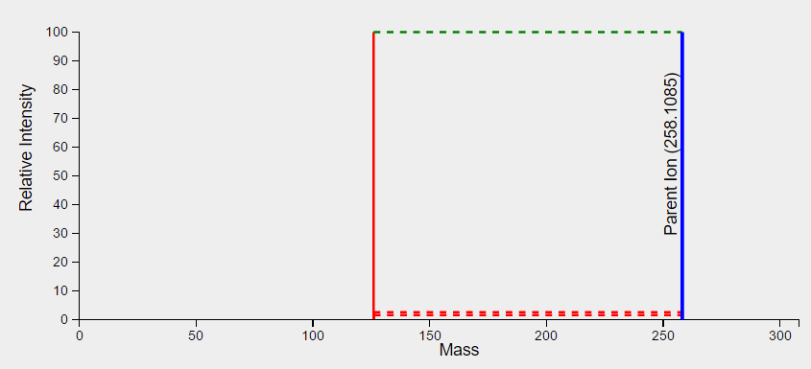
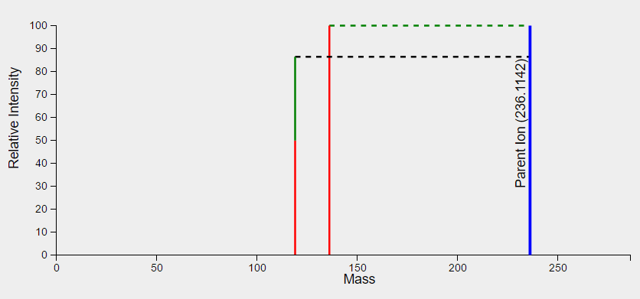
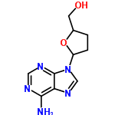
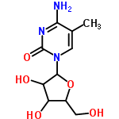
Does it work?
GNPS Tutorial Module – Substructure analysis with MS2LDA

Slide 7
LDA and Decomposition
Unsupervised discovery <--> LDA
Predefined motif search <--> Decomposition
?
?
?
?
?
?
?

Slide 8
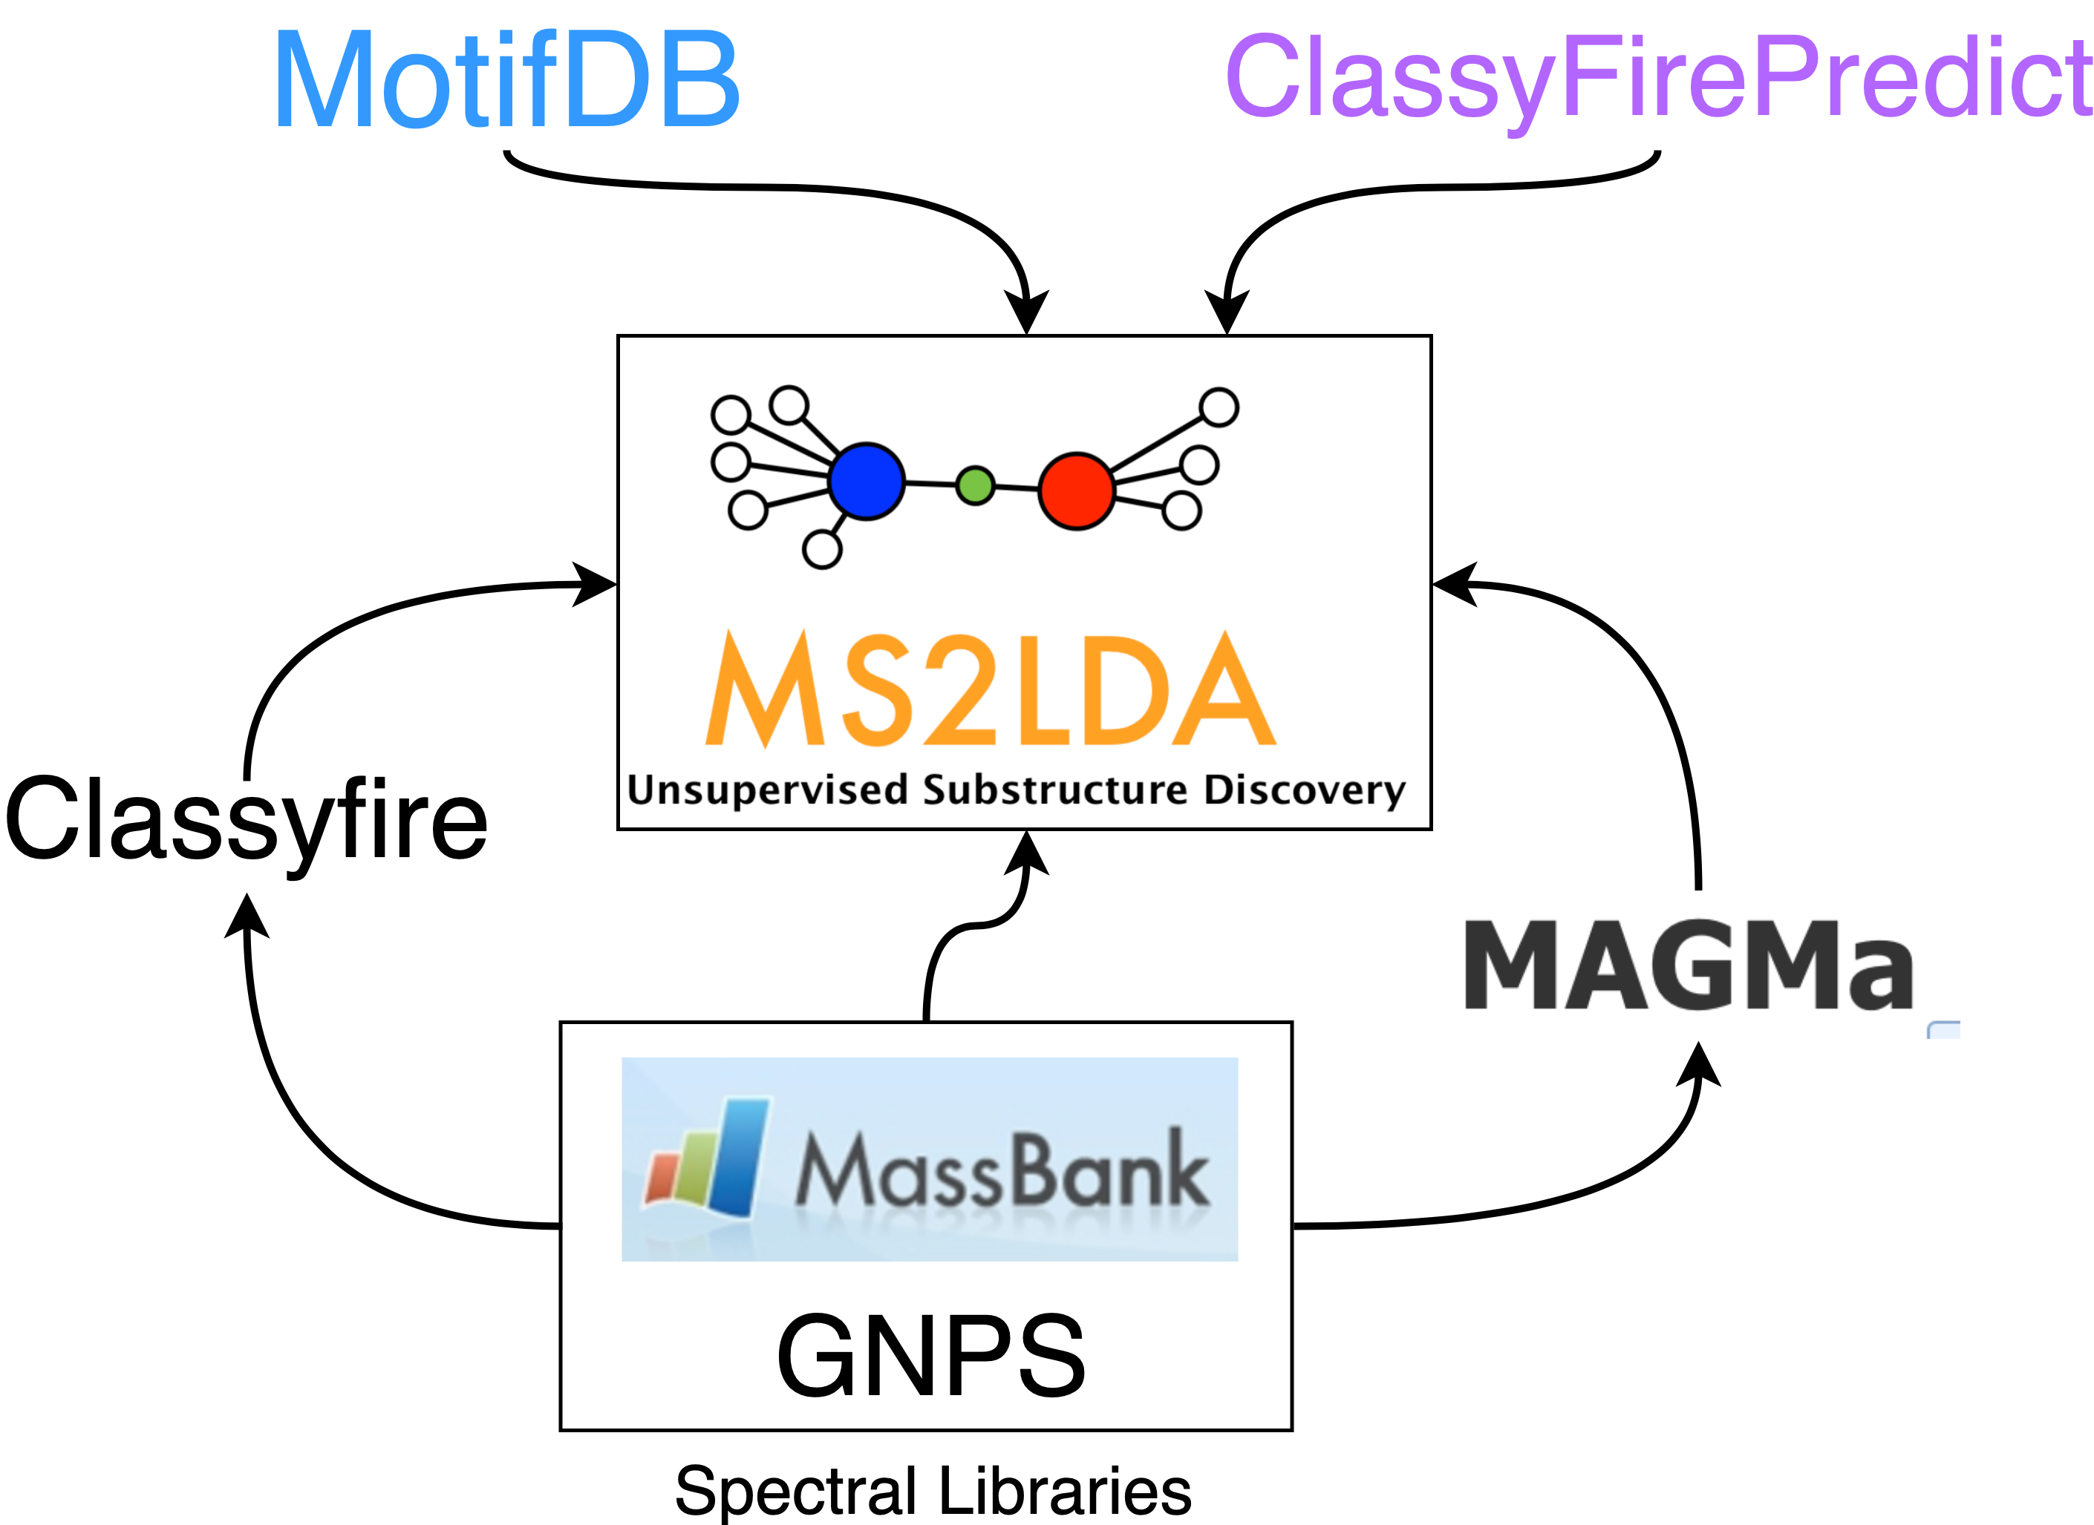
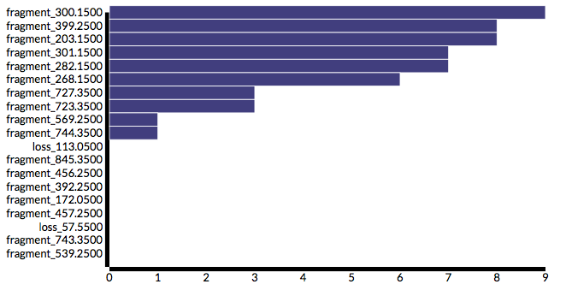
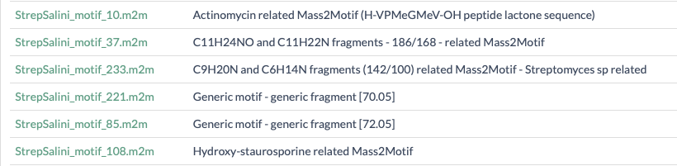
MotifDB – repository of annotated motif sets
Annotated motif sets
Annotated “fixed” motifs
+ free motifs

Slide 9
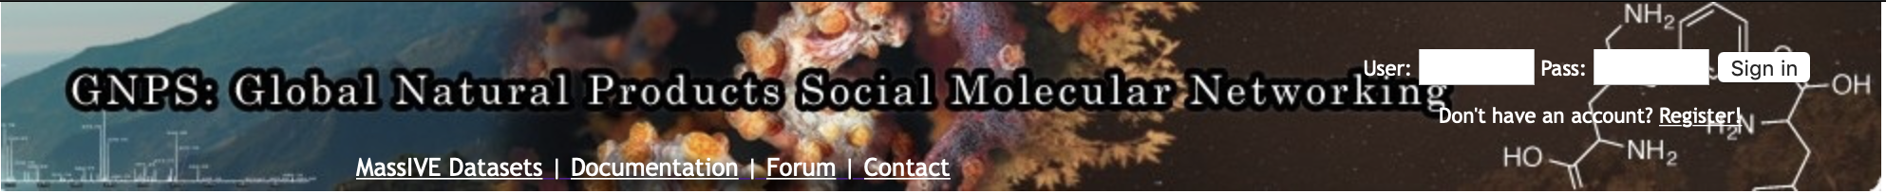
GNPS-MS2LDA integration
Run MS2LDA within GNPS
Quick overview of results
Direct link for M2LDA reanalysis from V2
Downloadable MS2LDA model for upload to ms2lda.org

Slide 10
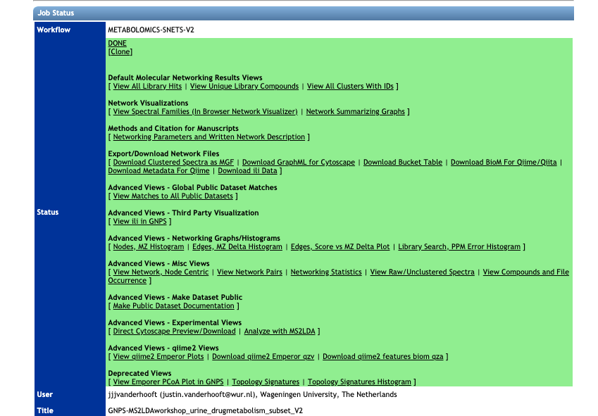
GNPS-MS2LDA
https://gnps.ucsd.edu/ProteoSAFe/status.jsp?task=7fff1d8a2d1641d2b9a098e58e41fb95
GNPS Tutorial Module – Substructure analysis with MS2LDA

Slide 11
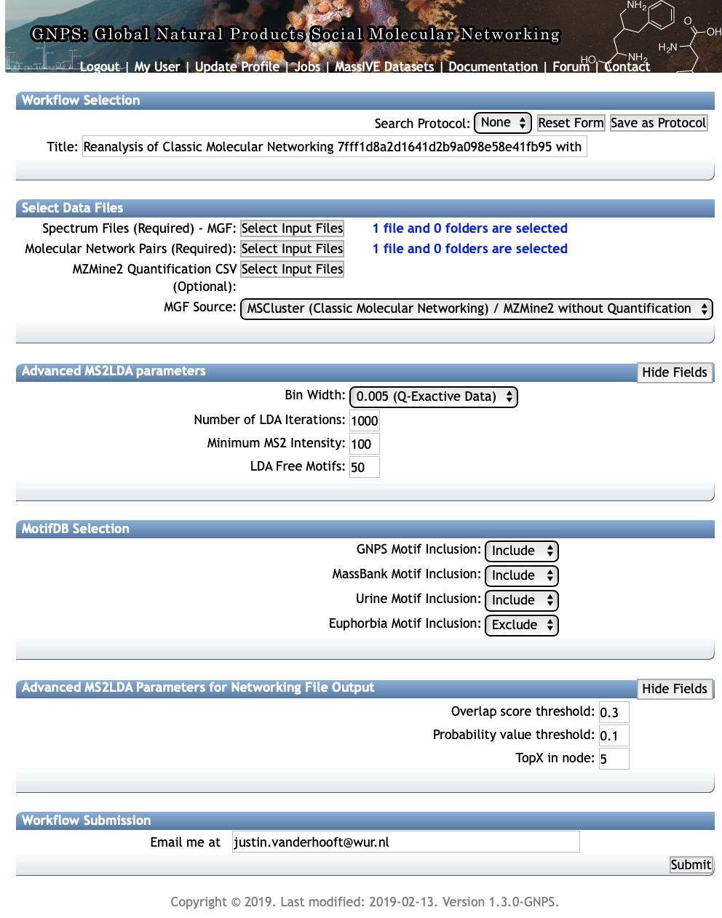
1. Name your GNPS-MS2LDA job
2. Automatically populated by GNPS
3. Depends on your MS instrument
Typical values are:
0.005 for Q-Exactive and
0.01 for ToF
4. LDA iterations: leave default of 1000
5. Minimum MS2 intensity, 100 is a good
Value for Q-Exactive, for ToF data ev. set to 0
6. Number of motifs (substructures) you expect in your dataset
7. Choose depending on your dataset (here urine, so include urine motifs!)
8. Default value is 0.3 and other typically used values are 0.2 and 0.1 - setting is dataset dependent, ev. upload the dict file and explore within ms2lda.org
9. Default value is 0.1 and other typically used values are 0.01 and 0.2 - setting is dataset dependent, ev. upload the dict file and explore within ms2lda.org
10. Top X Mass2Motifs with highest overlap score that will be mapped on network
11. Your email

Slide 12
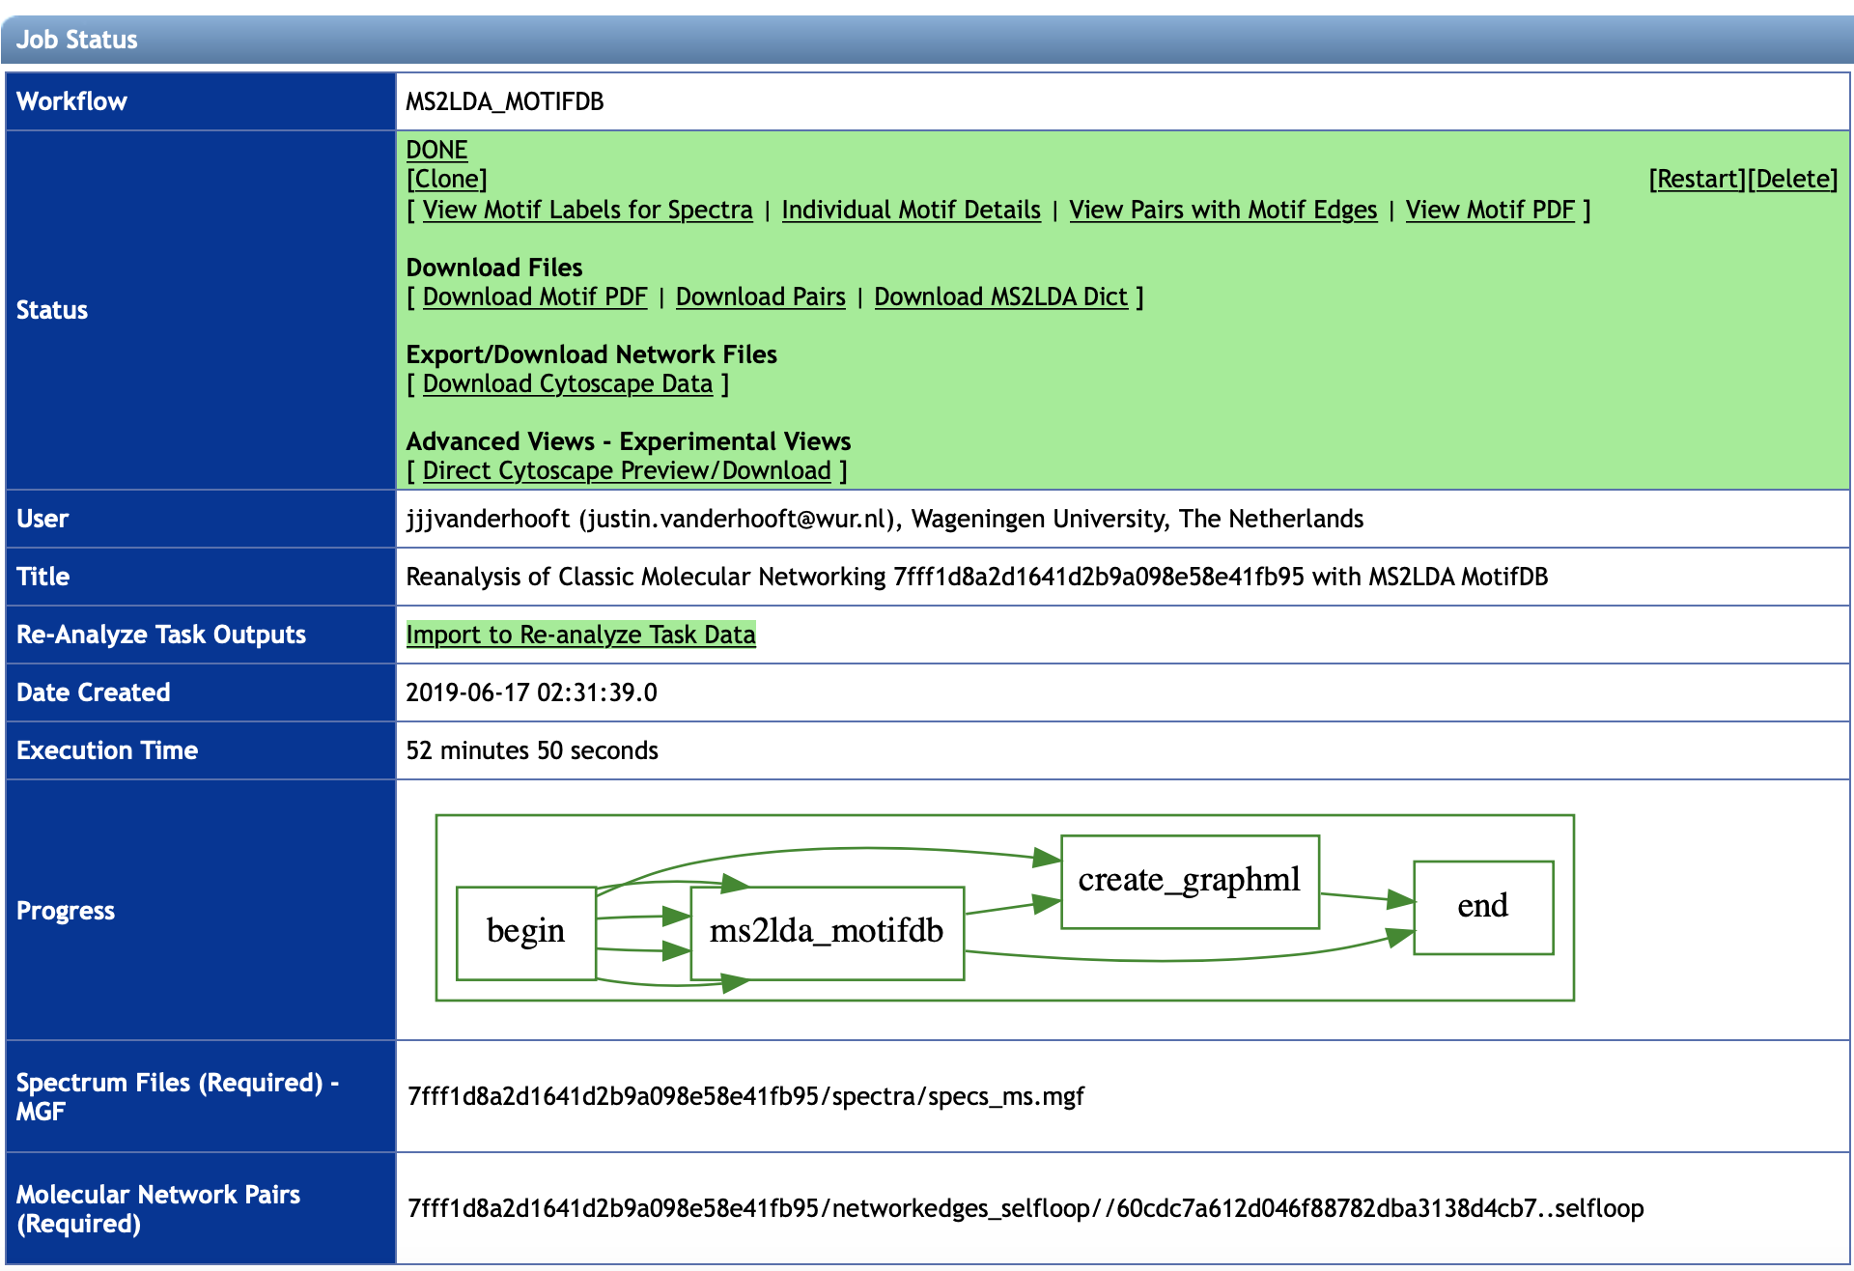
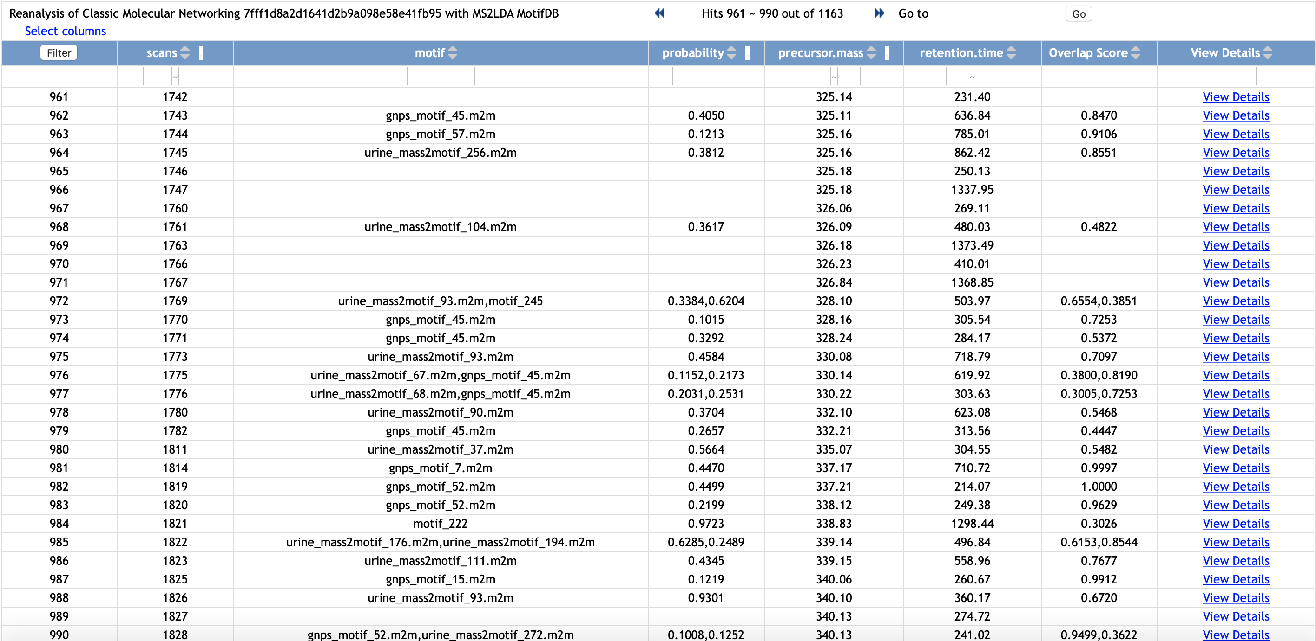
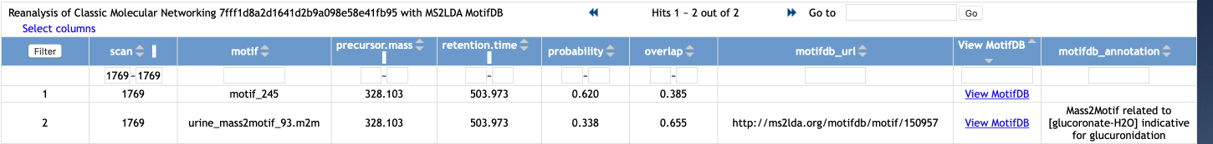

Slide 13
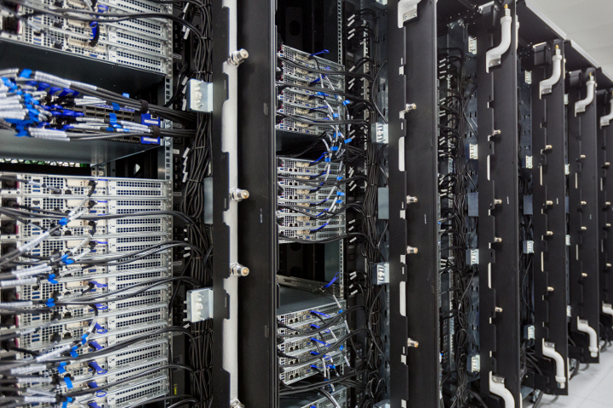
Runtime
Dependent on:
Number of motifs
Number of unique features (fragments/losses)
Number of fragmented molecules
Urine demo data:
261 motifs discovered of which 50 were free
8500 unique words from 20732 binned MS2 fragments
1163 MS1 peaks
Runtime: LDA took 1 hour on current web server
Populating database for visualization also takes time!
GNPS Tutorial Module – Substructure analysis with MS2LDA

Slide 14
MS2LDA.org
Inspect & Annotate Mass2Motifs
Visualize of substructures in network
Populate MotifDB
Generate substructure-mined data sets
GNPS Tutorial Module – Substructure analysis with MS2LDA

Slide 15
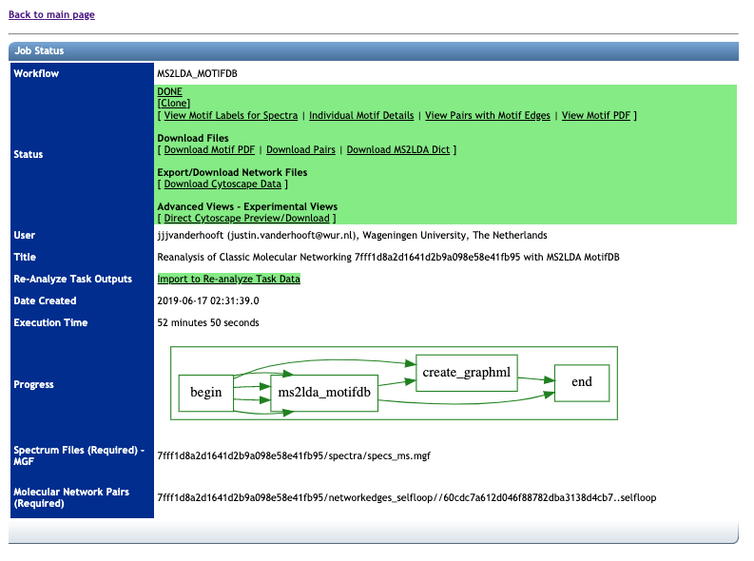
UPLOAD YOUR GNPS LDA EXPERIMENT TO MS2LDA.ORG
https://gnps.ucsd.edu/ProteoSAFe/status.jsp?task=8f56651e5910448584b8004207bb9099
GNPS Tutorial Module – Substructure analysis with MS2LDA

Slide 16
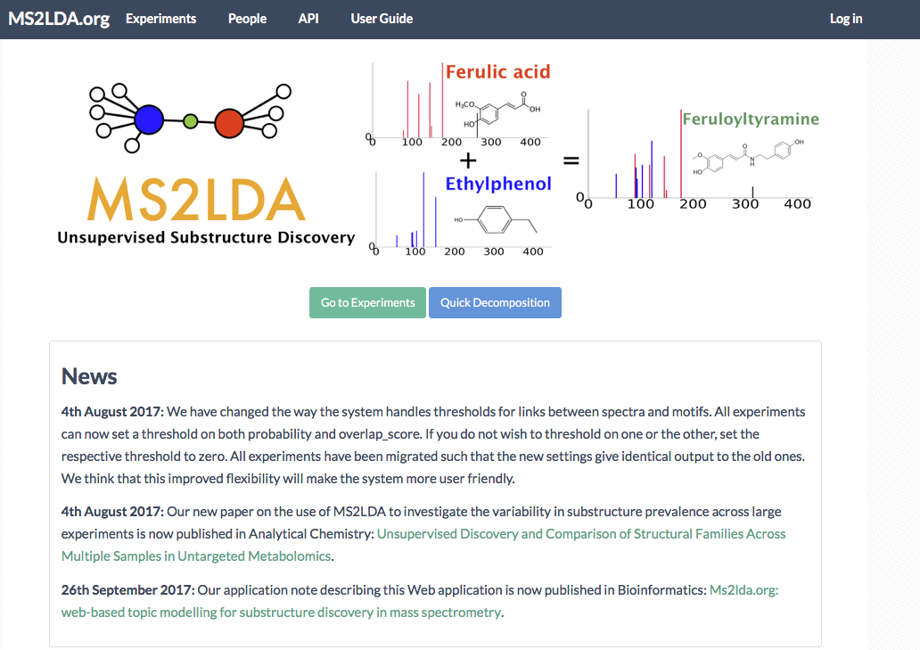
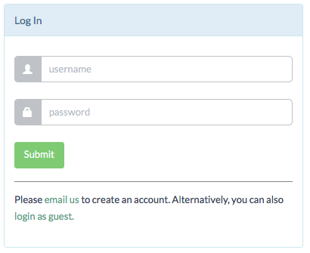
Username: GNPSworkshop2019
pw: metabolomics
GNPS Tutorial Module – Substructure analysis with MS2LDA

Slide 17
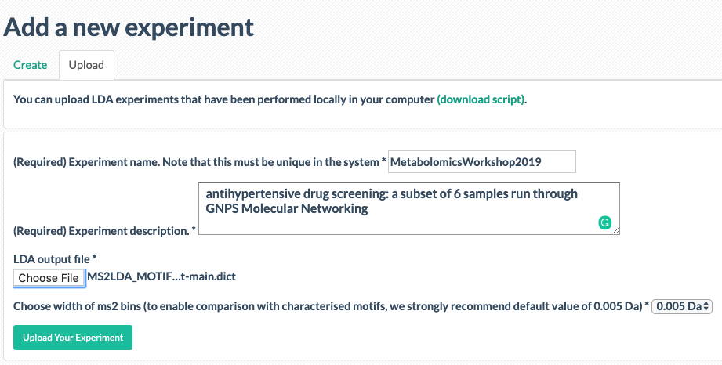
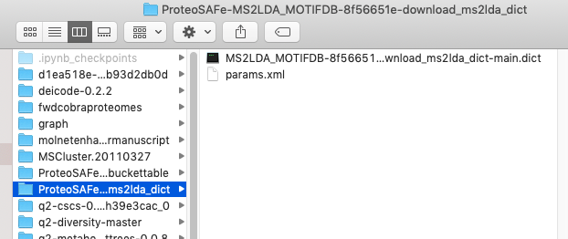
2. Name your MS2LDA job
3. Add a short description

Slide 18
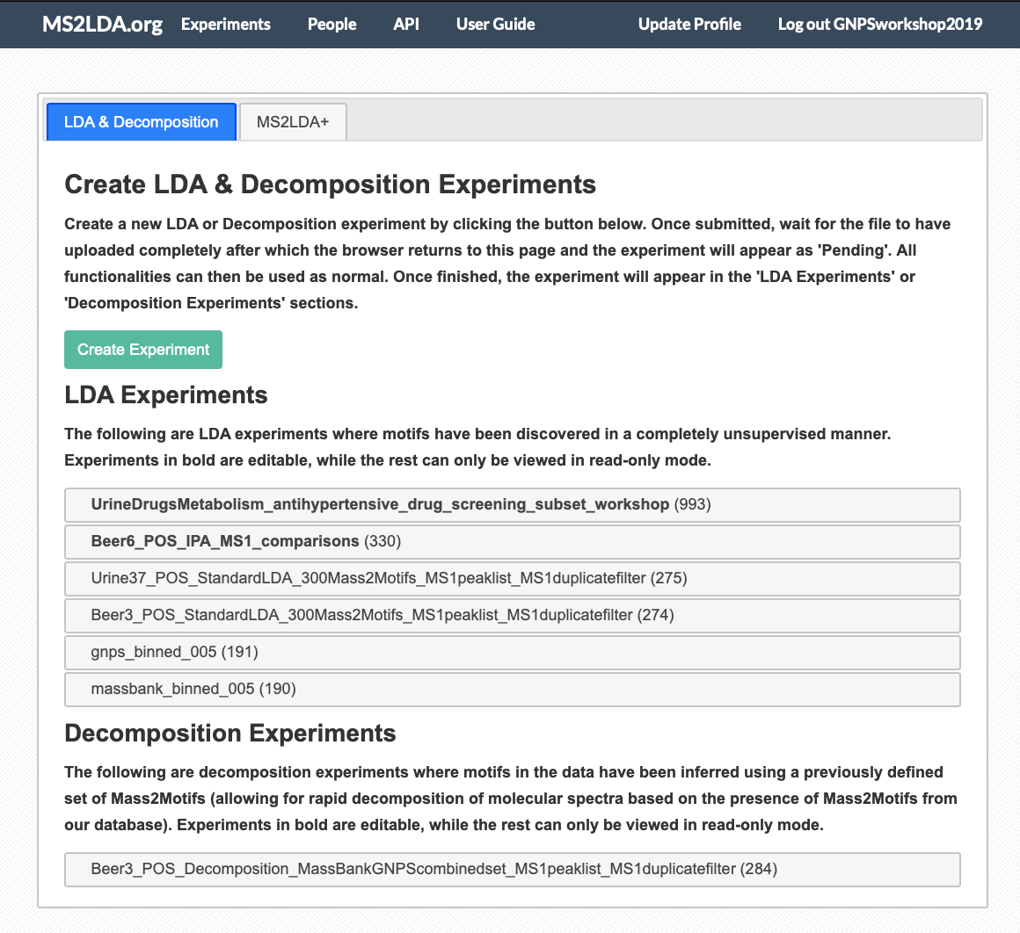
GNPS Tutorial Module – Substructure analysis with MS2LDA

Slide 19
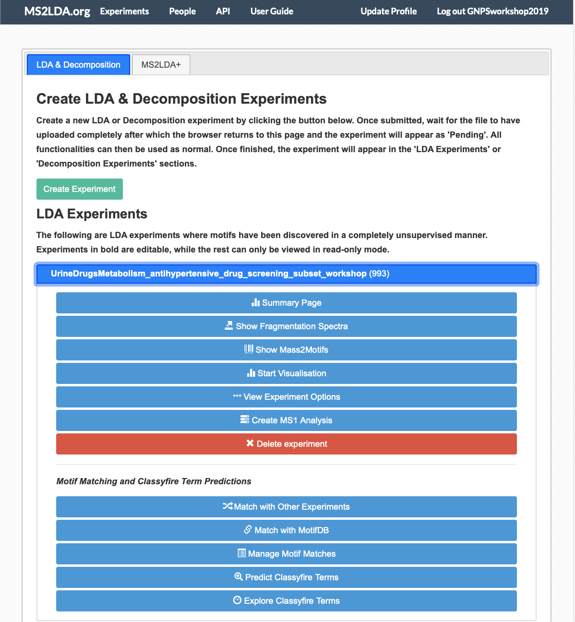
Browsing the data

Slide 20
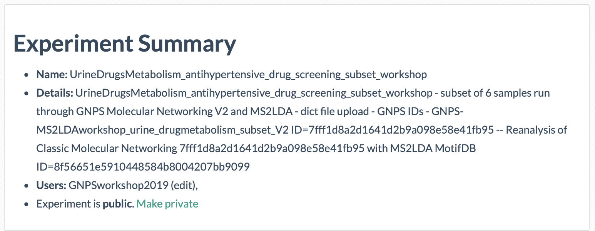
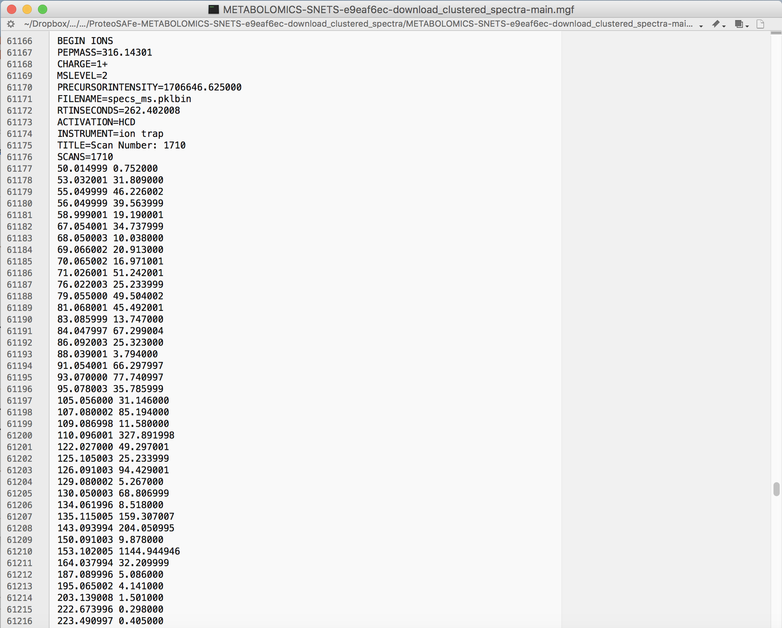

Slide 21
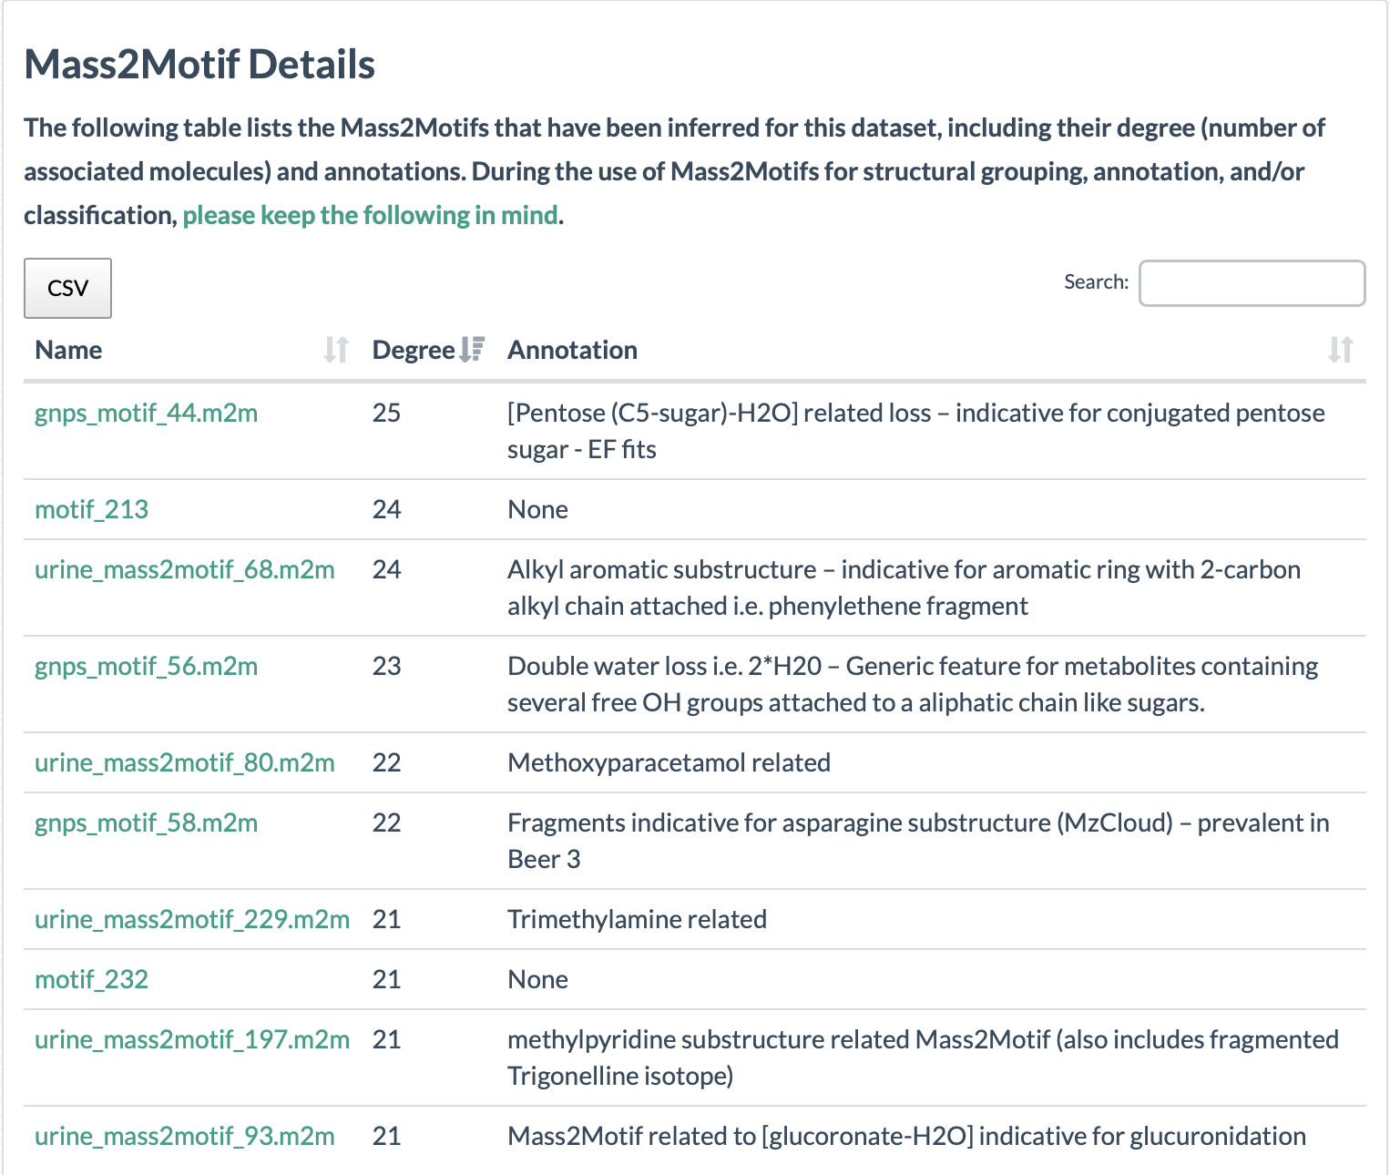
From MS2 to motifs: Mass2Motifs

Slide 22
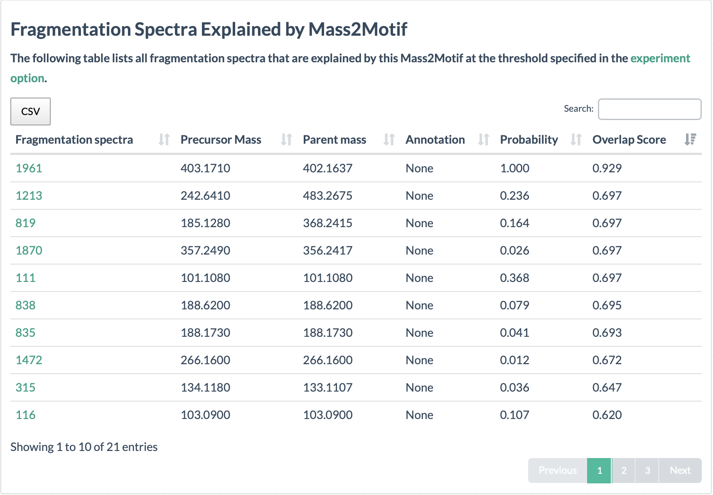
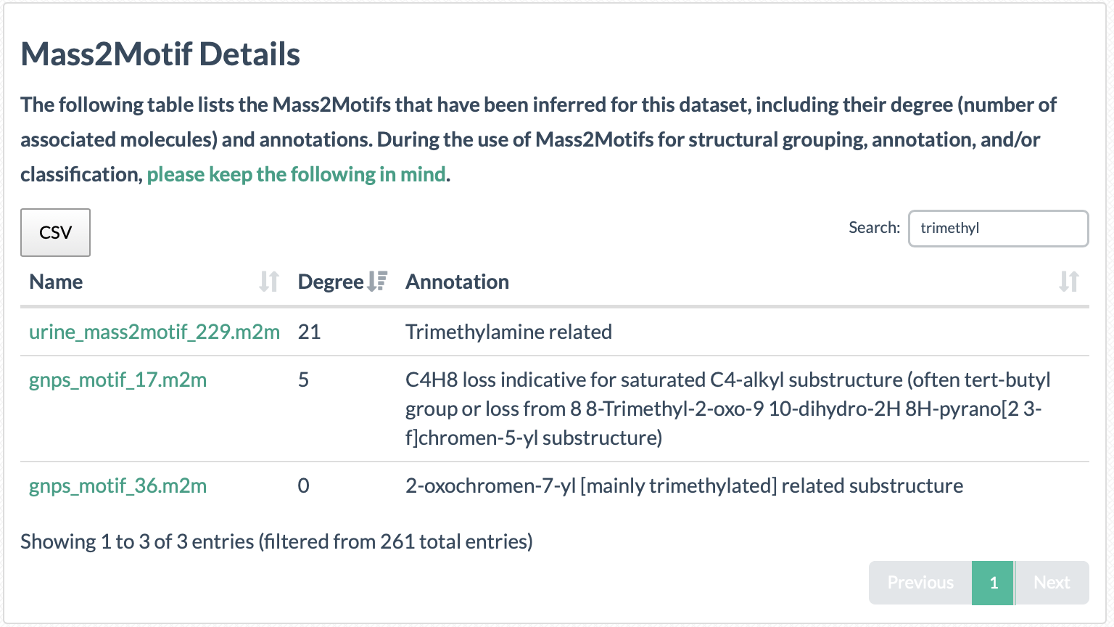
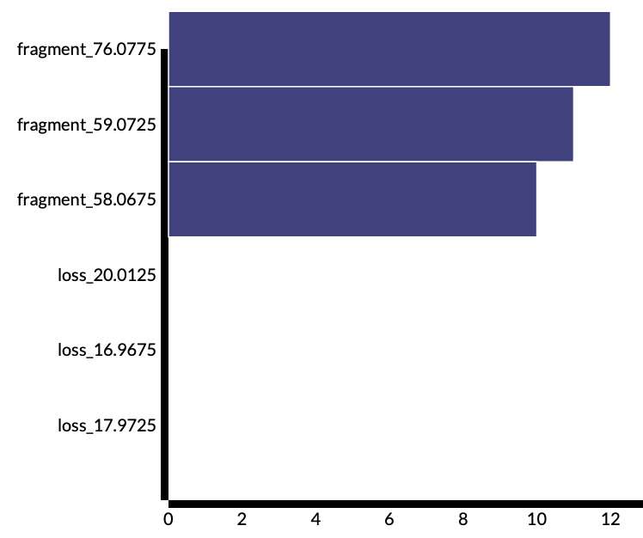
Mass2Motif
PARENT IONS
How to analyze and annotate Mass2Motifs?
FREQUENCY PLOT

Slide 23
Visualization

Slide 24
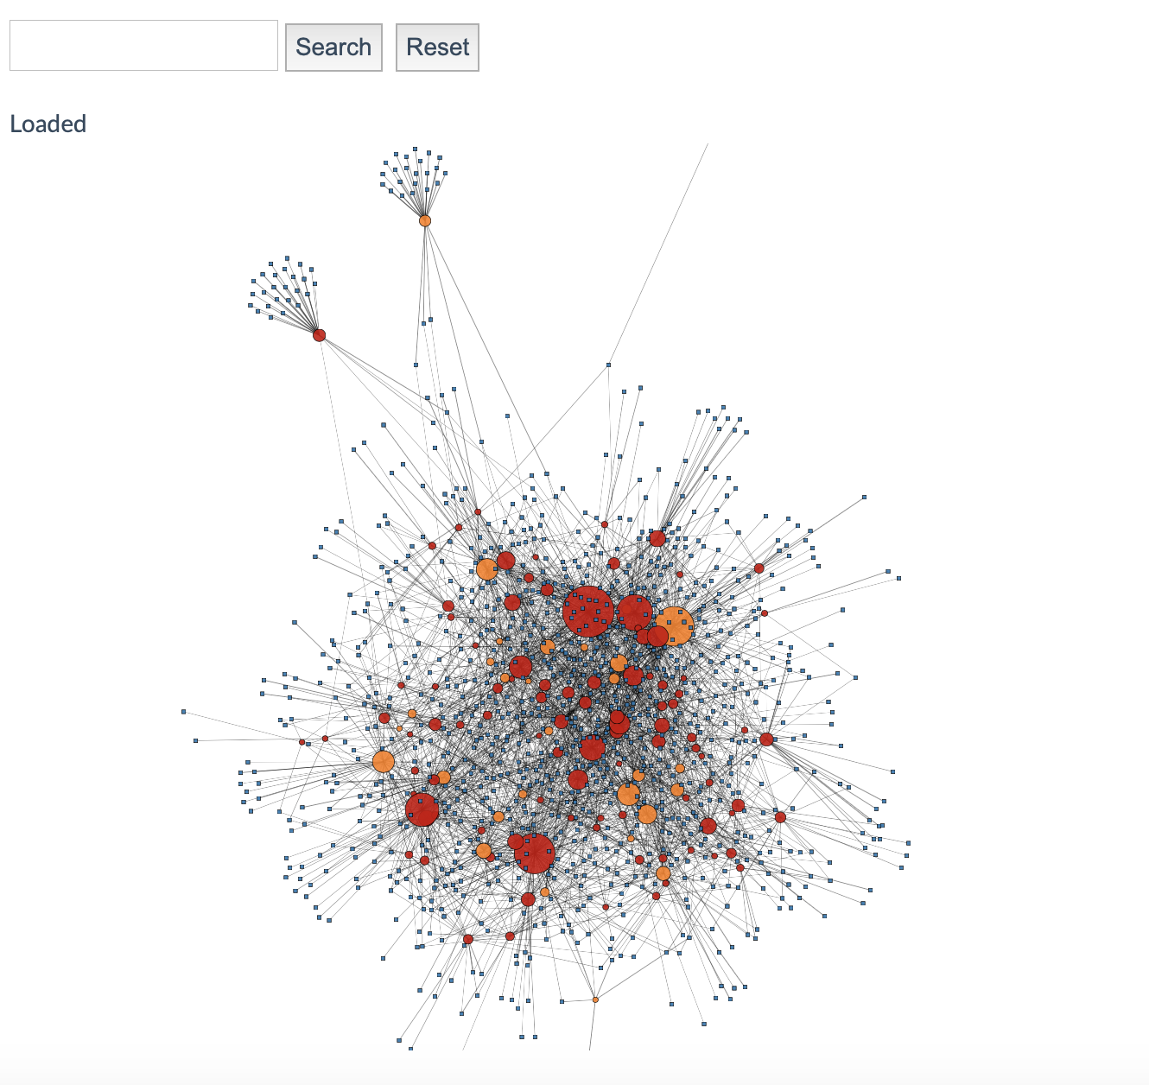
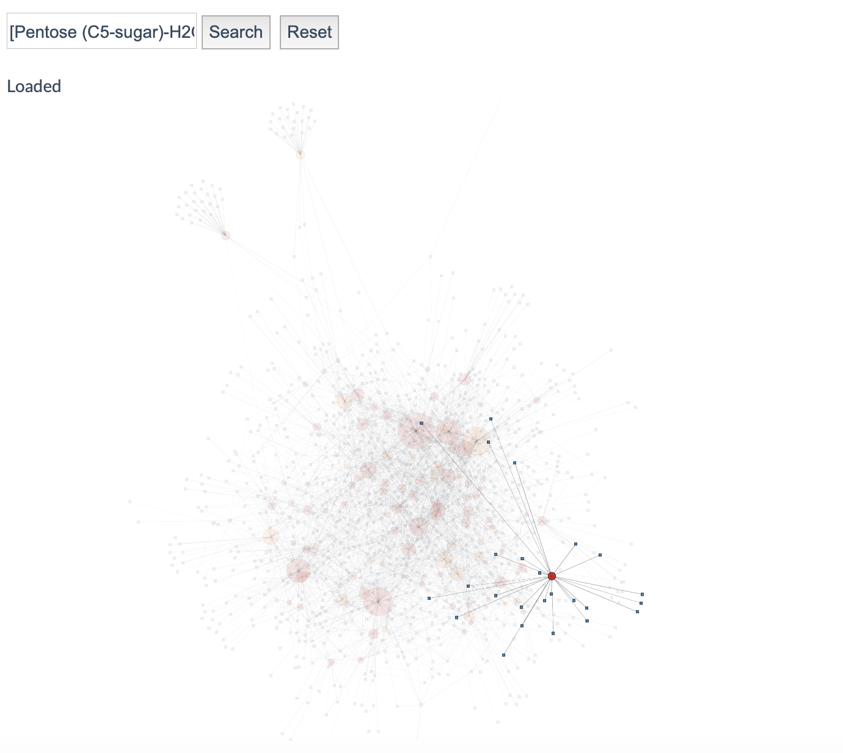

Slide 25
Workshop practice tasks (1)
How many histidine related molecules are present in the urine data? What are these molecules and why are they present in urine?
How many trigonelline metabolites are present in the urine data? Can you find indications as to why these metabolites are present in human urine?
GNPS Tutorial Module – Substructure analysis with MS2LDA

Slide 26
Workshop practice tasks (2)
How many drug related annotated motifs (degree >= 5) can we find?
This paper* describes the background of the data – a subset of urine samples described there was used for this MS2LDA experiment. Does this back up your findings? And do the fragmental patterns make sense?
Multiple substructures are sometimes found. Glucuronidation is a human phase II biotransformation – can you find molecules linked to other annotated motifs and say something about their structures? Additionally, can you further annotate a non-dipeptidic histidine metabolite?
*https://link.springer.com/article/10.1007/s11306-016-1064-z
GNPS Tutorial Module – Substructure analysis with MS2LDA

Slide 27
Questions, Problems or Bugs?
bix-lab.ucsd.edu/display/Public/GNPS+Documentation+Page
groups.google.com/forum/#!forum/molecular_networking_bug_reports
mwang87@gmail.com
lnothiasscaglia@ucsd.edu
enmeilin@gmail.com
zdenek.kamenik@email.cz
Justin.vanderHooft@wur.nl
pdorrestein@ucsd.edu
GNPS Tutorial Module – Substructure analysis with MS2LDA

Slide 28
Extra slides with answers from here
GNPS Tutorial Module – Substructure analysis with MS2LDA

Slide 29
MS2LDA Workshop practice tasks answers (1)
9 histidine containing MS1 features – mainly dipeptides – protein degradation is a likely explanation.
3 Trigonelline containing MS1 features – Trigonelline is a biomarker for coffee, legumes, and soy products and is most likely diet-derived.
GNPS Tutorial Module – Substructure analysis with MS2LDA

Slide 30
MS2LDA Workshop practice answers (2)
8 drug-related motifs -->
Mass2Motif related to benzenesulfonylamide substructure,
Mass2Motifs related to paracetamol, methoxyparacetamol and paracetamol mercapturate,
Mass2Motif related to Verapamil structure
Mass2Motif related to sartan-based drugs (Irbesartan, Valsartan),
Mass2Motif related to Clopidogrel
Mass2Motif related to Diltiazem
Yes, mainly antihypertensive drugs and the fragments in the Mass2Motifs correspond well to those listed in the supporting information of the paper.
Paracetamol-O-glucuronide, two glucuronidated Verapamil metabolites – N-pentosylated histidine
GNPS Tutorial Module – Substructure analysis with MS2LDA

